Slide 1


Error Handling, External Interfaces and Lifecycle Management with System Center 2012 SP1 Orchestrator Andreas Rynes Datacenter Architect Microsoft Corporation
Microsoft Virtual Academy
Notes:
Welcome to Microsoft Virtual Academy to another session about System Center 2012 Orchestrator. This time we are going to talk about error handling, external interfaces and lifecycle management with System Center 2012 SP1 Orchestrator. My name is Andreas Rynes. I am a Datacenter Architect at Microsoft and those are actually the objectives for today.

Slide 2
Objectives
Discuss how to build error handling into SCO runbooks
Understand proper lifecycle management processes for versioning and promotion of SCO runbooks
Notes:
As with IPv4, subnetting is an important key area that you must grasp. Subnetting enables IPv6 to provide a globally routable, hierarchical mechanism for ensuring rapid and efficient packet delivery.
By the end of this module, you should be able to:
Describe how IPv6 uses subnets
Contrast IPv6 subnetting with IPv4
Calculate IPv6 subnet boundaries
Explain how to configure IPv6 subnets
TRANSCRIPTION STARTS HERE
First of all, I would like to discuss how to build some error handling within your runbooks and I would also like to give you an understanding for a proper lifecycle management process and how to do versioning and promotion of your Orchestrator runbooks. Actually, those topics are quite important and especially if you are looking into more complex scenarios with Orchestrator that might really help you and save you a lot of time.
Objectives
Start Time 00:01 / Length: 1 minute
Microsoft Lync tools used on this page:
None
Review the learning objectives.

Slide 3
Agenda
Adding Error Handling to runbooks
Lifecycle Management
Runbook Install, Upgrade & Promotion
Initiating runbooks remotely
Methods & Use Cases
Notes:
When starting out your definition of your IPv6 subnet and addressing plan, you should follow this process:
Start off by determining the basic structure of the Addressing Plan. How many subnets will you need in total? How are you going to define your subnets – do you want them by country, city, location, building or floor?
You need to define your primary subnets and identify if your IPv6 subnets will be the same as your IPv4 subnet boundaries or different. If you are unhappy with your current IPv4 subnetting arrangements, moving to IPv6 gives you the opportunity for a fresh start.
You then calculate the address space required for the addressing plan of choice by following these steps:
Determine number of locations (or groups) that you need.
Increase this number by one (for backbones, etc.)
Add one extra group for roaming networks
Add one or two groups for future expansion
Round up the number of bits counted in steps 1 to 4 to the nearest power of 2
This figure now gives you the number of bits that you need to subnet.
TRANSCRIPTION STARTS HERE
The agenda for today is how to add error handling to runbooks, then lifecycle management and how to do that with Orchestrator. Then, we will talk a little bit about how to install, upgrade and promote runbooks and then how to initiate runbooks remotely and some methods and use cases here as well.
IPv6 Subnet and Address Planning
Start Time 00:04 / Length: 3 minutes
Microsoft Lync tools used on this page:
None
Take the students through the subnet and address plan. Explain the various stages of how the plan comes together.

Slide 4
Adding Error Handling to Runbooks
There are multiple options to build error handling into SCO runbooks
Use link logic (filtering) to trigger runbook error-handling measures
Dedicated (child) error handling runbooks that can be reused across new runbooks
Use Foundation Notification objects or the SCOM IP's Create Alert object (or like object in other IPs) to send notifications as part of the error handling process
Create Service Manager Incidents for errors with the SM Integration Pack
Notes:
First of all, I would like to talk a little bit about error handling and how to make that happen into runbooks.
There are multiple options on how to build error handling into your runbooks. First of all, you can filtering and link logic to trigger runbook error-handling measures. For example, if your runbook defines an output you are able to filter on that output on the links and say, well if the exit code of that activity is zero than it was a success and I would like to go on to the next activity. If the exit code was something else than zero, maybe -1 or 1, than I know it is an error and I would like to take measures here. This might involve another link to another activity where you are creating some sort of error handling in there. A good idea is having dedicated runbooks for your error-handling, especially if you want to reuse them in other runbooks as well so before you even start tackling your runbooks that do the real stuff, you might think about some generic error-handling runbooks that really grab some data, for example, some sort of exit code. Some error text, for example, and you can deal with that and you can think of writing that to a file or you are sending an email out to someone you might use operations manager to create an alert.
The next point here is use foundation notification objects or SCOM IP create alert object that is a way to notify someone or a group of people about an error happening in your runbook so that could be part of an error handling routine or runbook that you are going to reuse again and again in your runbooks.
Another way is, of course, using service manager and creating an incident, for example, so you are able to use integration pack for service manager that will, when an error happens, grabs the text of your error and add that to an incident within service manager and, of course, you can work with other service management tools that accepts service manager that you are working with in your company and create an incident there as well or just send out an email, for example, that would work as well.
Think of your error handling technique or idea first and create those error handling runbooks first and then start working with your real runbooks that will reuse that error handling techniques in runbooks.

Slide 5
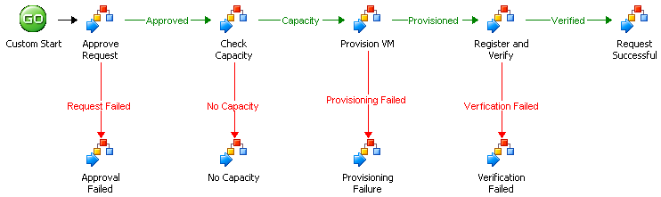
Sample VM Provisioning Workflow
Validation and handling of resource availability and pre-flight outcome
Link filtering to direct workflow based on object or policy output
Triggering error processing policies
Notes:
Here we are seeing a sample of VM provisioning workflow and at the very top from left to right you see the successful way of how to provision of VM. From custom start it will approve some requests. It will check capacity. It will provision VM. It will register and verify something and it will have a runbook that will say that the request was successful. With every activity here on the top there is some sort of validation and in the link you will have a filter that checks that output and validates the output if it was successful or not and if it goes from left to right everything is successful, no error occurs and nothing happened here.
In case there is an error in one of those activities, you can use the filtering on the links and say okay if the output is an error than you would like to go to the bottom and call another workflow here that will actually handles the error. Those 4 different runbooks down here are really calling those generic error runbooks so everyone of those 4 will call the same runbook that will define the same parameters and those 4 will pass in those parameters from the activity that failed before.
To show you that a little bit better, I would like to go to Orchestrator to the designer and show you that in a real world example and how to make that happen in your environment as well.

Slide 6
Notes:
Demo – Error Handling
Now I would like to switch to the designer, to the Orchestrator designer, to show you an implemented runbook or a couple of runbooks showing you how to deal with error handling in Orchestrator.
I would like to show you an idea of how to deal with error-handling in Orchestrator. What you see here is a pretty simple runbook that is called error routing. It has 1 custom start defined here. If we double click on that we have a couple of input parameters defined. For example, an request ID, an error status, an error message; all the information that might be interesting for dealing with an error. Those are defined here for that error routing runbook .
Then, what it actually does is send an event log with the information that it got from the custom start from the initiate activity here so it will add an error log with information that are passed in to that runbook. That is 1 activity.
Another activity is it is going to use System Center 2012 Service Manager and it will create an incident with a template so if you double click here on that so you see a connection to the service manager it will use a specific clause. It is the incident clause. It will use a specific template and in this case we are using the default incident template and then it will define a couple of things for that incident, for example: impact, urgency, you can define what is the source for that incident. In this case it comes from Orchestrator and actually it is an old one from Opalis, so the days when Orchestrator was called Opalis. A couple of published information that was passed into that error routine runbook will be used here as well. For example, the error status and the error text message will be used in the description of that incident. You can think of your error handling in one of those runbooks that you can use your own help ticketing system. If it is not service manager you can write to the event log. You can send out emails. You can send out or write files for specific share, for example; a couple of different things on how to deal with errors. But, this is 1 single error route in runbook.
Now let’s go ahead and see 1 of the runbooks that we have here. Let’s use that one. This is how to create a virtual machine with a fixed template. We have from the very left to the very right we have that successful way of dealing with that runbook. if everything works fine it will just flow from the left to the right. If there is an error or a warning for 1 of the activities up here, it will have a link that is defined as the activity here and if it returns a warning or a failure it will go down this way and it will use that activity here and actually you will find that in the runbook control activity it is called Invoke Runbook and if we double click on that you will see that it will call the error routing runbook that we saw before and it will pass in the parameters that are defined with the error routing. It has some trace information. It has a request ID, it has a policy name so we say well the runbook is to create virtual machine fixed template so we add that hard-coded here and we have the error status so we are using the object status of the activity, the object name, actually it is Get Request and then we are using, well that’s wrong. we are using the arrow so we are using published data so from the Get Request we are using the error summary text (okay, that is all data here so let’s remove that and use the right one, subscribe published data, so we are using the error summary text) of the Get Request activity. Now we click on finish. For every activity up here you are using the same error routing that really does the thing on every error. So, in our case it writes to the event log and it creates an incident in service manage, but you can think of your solution to error handling so what you have done in the past so you can implement a couple of different things, but most importantly that you are going to use the same error routing runbook in every of your other runbooks.

Slide 7
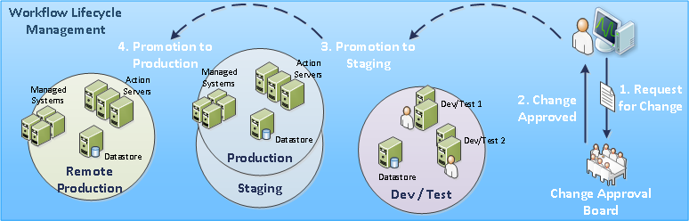
Promotion, Deployment & Update
A standard Software Development Lifecycle Process can be implemented to support runbook promotion
Fully developed, tested and sanitized runbooks should be submitted through a Change Control process
Runbook Lifecycle Management
Notes:
If you are familiar with software development you probably have heard about software development lifecycle processes and the same is true for runbooks and for your runbook lifecycle management so you can implement some sort of lifecycle process to support your runbook promotions. You also should implement some sort of change request process or change control process so if there is a change for an existing runbook it should go through an approval board that will work with that change request and approve or check that change request and then you probably will work in development and test environment were really separated from the production and from there you are able, if your change is implemented there, then you are able to promote that to a staging environment for integration tasks and a couple of other things that you want to test before you would like to really promote that to your production environment. This is how a simple runbook lifecycle process can look like and there is really no reason why not implementing that and why not use the same techniques for runbook development as you would do for other software development as well because runbooks are nothing else than software that you would like to develop and you would like to promote that to different areas and different stages.

Slide 8
Maintaining Version History
SCO does not have automatic rollback or built-in version history
*.ois_export files should be treated as managed code
Exports should checked in and checked out from a source control system outside SCO.
Once the current environment has been backed up, and the newly approved runbooks have been stored, they can be scheduled for deployment
IMPORTANT!
It is crucial that if more than one production environment that each one of them is backed up and updated at the same time to keep the environments in sync.
Notes:
How to do versioning and maintaining the version history.
Orchestrator unfortunately does not have any automatic rollback or built-in version history stuff so what you should do is really export your runbooks and treat that as managed code so you are able to export that and import that. For the lifecycle process that is how you would do it, you just export your runbooks and import that in the next stage and you should treat that as managed code so export your runbooks and add that to your source control system. Whatever you are going to use; Team Foundation Server or others. Just check it in there and check it out there if you want to work with that. That really is the way to do version control and version history with your runbooks. Actually, the export files are XML files so you are able to open that with your XML editor and have a look what’s in there as well. Of course, once the current environment has been backed up you are able to store your newly approved runbooks and you are ready to do the deployment and schedule your deployment as well.
It is really important to understand that Orchestrator does not have any version history built in, but you are able to really use your existing source control system that you already have in place or you look into, for example, Team Foundation Server and that really offers you version and source control from Microsoft and you are able to use that with Orchestrator runbooks as well.

Slide 9
Initiating Runbooks Externally
Runbooks can be triggered from outside the SCO user interfaces
Methods to initiate policies remotely
SCO Web Service
Command line Tools – SCO Job Runner (Codeplex)
Service Manager Integration – Service Request
OIS5StartPolicy.exe (Deprecated – replaced by WebService)
Notes:
How to initiate runbooks externally?
One way to really run a runbook is to go to your runbook designer and start it from there, but in most cases you would like to have another way to trigger your runbooks externally and probably the best way to do that is using the new WebService of Orchestrator so there is a REST-based WebService that will be deployed with your Orchestrator management server and you can use that WebService to call or initiate your runbooks remotely.
Then there is 1 command line tool which is published on Codeplex so you go to www.codeplex.comand you will find the Orchestrator Job Runner which is a command line tool which gives you the option to initiate a runbook from the command line using that program, the Orchestrator Job Runner.
Another way or method to initiate a runbook is to use the Service Manager Integration. In cases where you have already deployed service manager in your environment and you are using service manager or you think about that, there is really a deep integration between service manager and Orchestrator. With service manager you can build a service request that is more a business process that you want to implement in your environment, but this service request can call Orchestrator runbooks to do some technical automation or technical processes and have those integrated in your business processes. For example, if you think back to the example about the VM provisioning request, that might be a service request that you might want to publish on your service manager portal and some user is able to request a new VM using that portal and say, okay I would like to use a new VM. It has to has 8 gig of memory and this size of disc space and the user will just create that request in that portal. From there, the service request will kick in and the first thing it will have is an activity that checks for approval. For example, the line in manager that is defined in the active directory has to approve that service request so it will go out and send an email to that manager and will ask for approval. If that happens, the next activity might be a manual process where someone from the IT department has to do some manual stuff just to give you an idea of some of the different options here and then maybe the first activity will be calling an Orchestrator runbook that really will do the technical stuff and will create the VM and will add the disc space and will deploy operating system and will deploy an agent or a different software, whatever, it is defined in that runbook or in those runbooks and that is all part of a simple and single service request and that is pretty easy to build with the integration between service manager and Orchestrator. All of your Orchestrator runbooks will be or can be integrated and imported into service manager with a single setup of a connector which happens in less than a minute and then you have an integration between service manager and Orchestrator.
The last option here is called an executable that you can use from the command line which is deprecated and is replaced by the WebService mentioned in the first place. So, the first option is using the WebService, especially if you want to integrate that in another environment, if you have a non-Microsoft portal for example where you would like to call in and initiate runbooks then the best way to do that is using the WebService of Orchestrator to do that.

Slide 10
Summary
Understanding error handing options for SCO runbooks
Runbook Lifecycle Management
Best practices for runbook promotion
Options for maintaining version history
Review of methods to initiate a runbook from outside the SCO user interfaces
Notes:
Summary about that session.
I hope I gave you some ideas and an understanding of error handling and how to do that with Orchestrator. We also tackled the lifecycle management and how to deal with runbooks and how to deploy and promote and use things like source control with your runbooks and last, but not least, review all the methods that are out there to initiate a runbook from outside of Orchestrator, of course, because you are always able to use the designer for that, but very often you would like to use another system or trigger that runbook from outside.

Slide 11
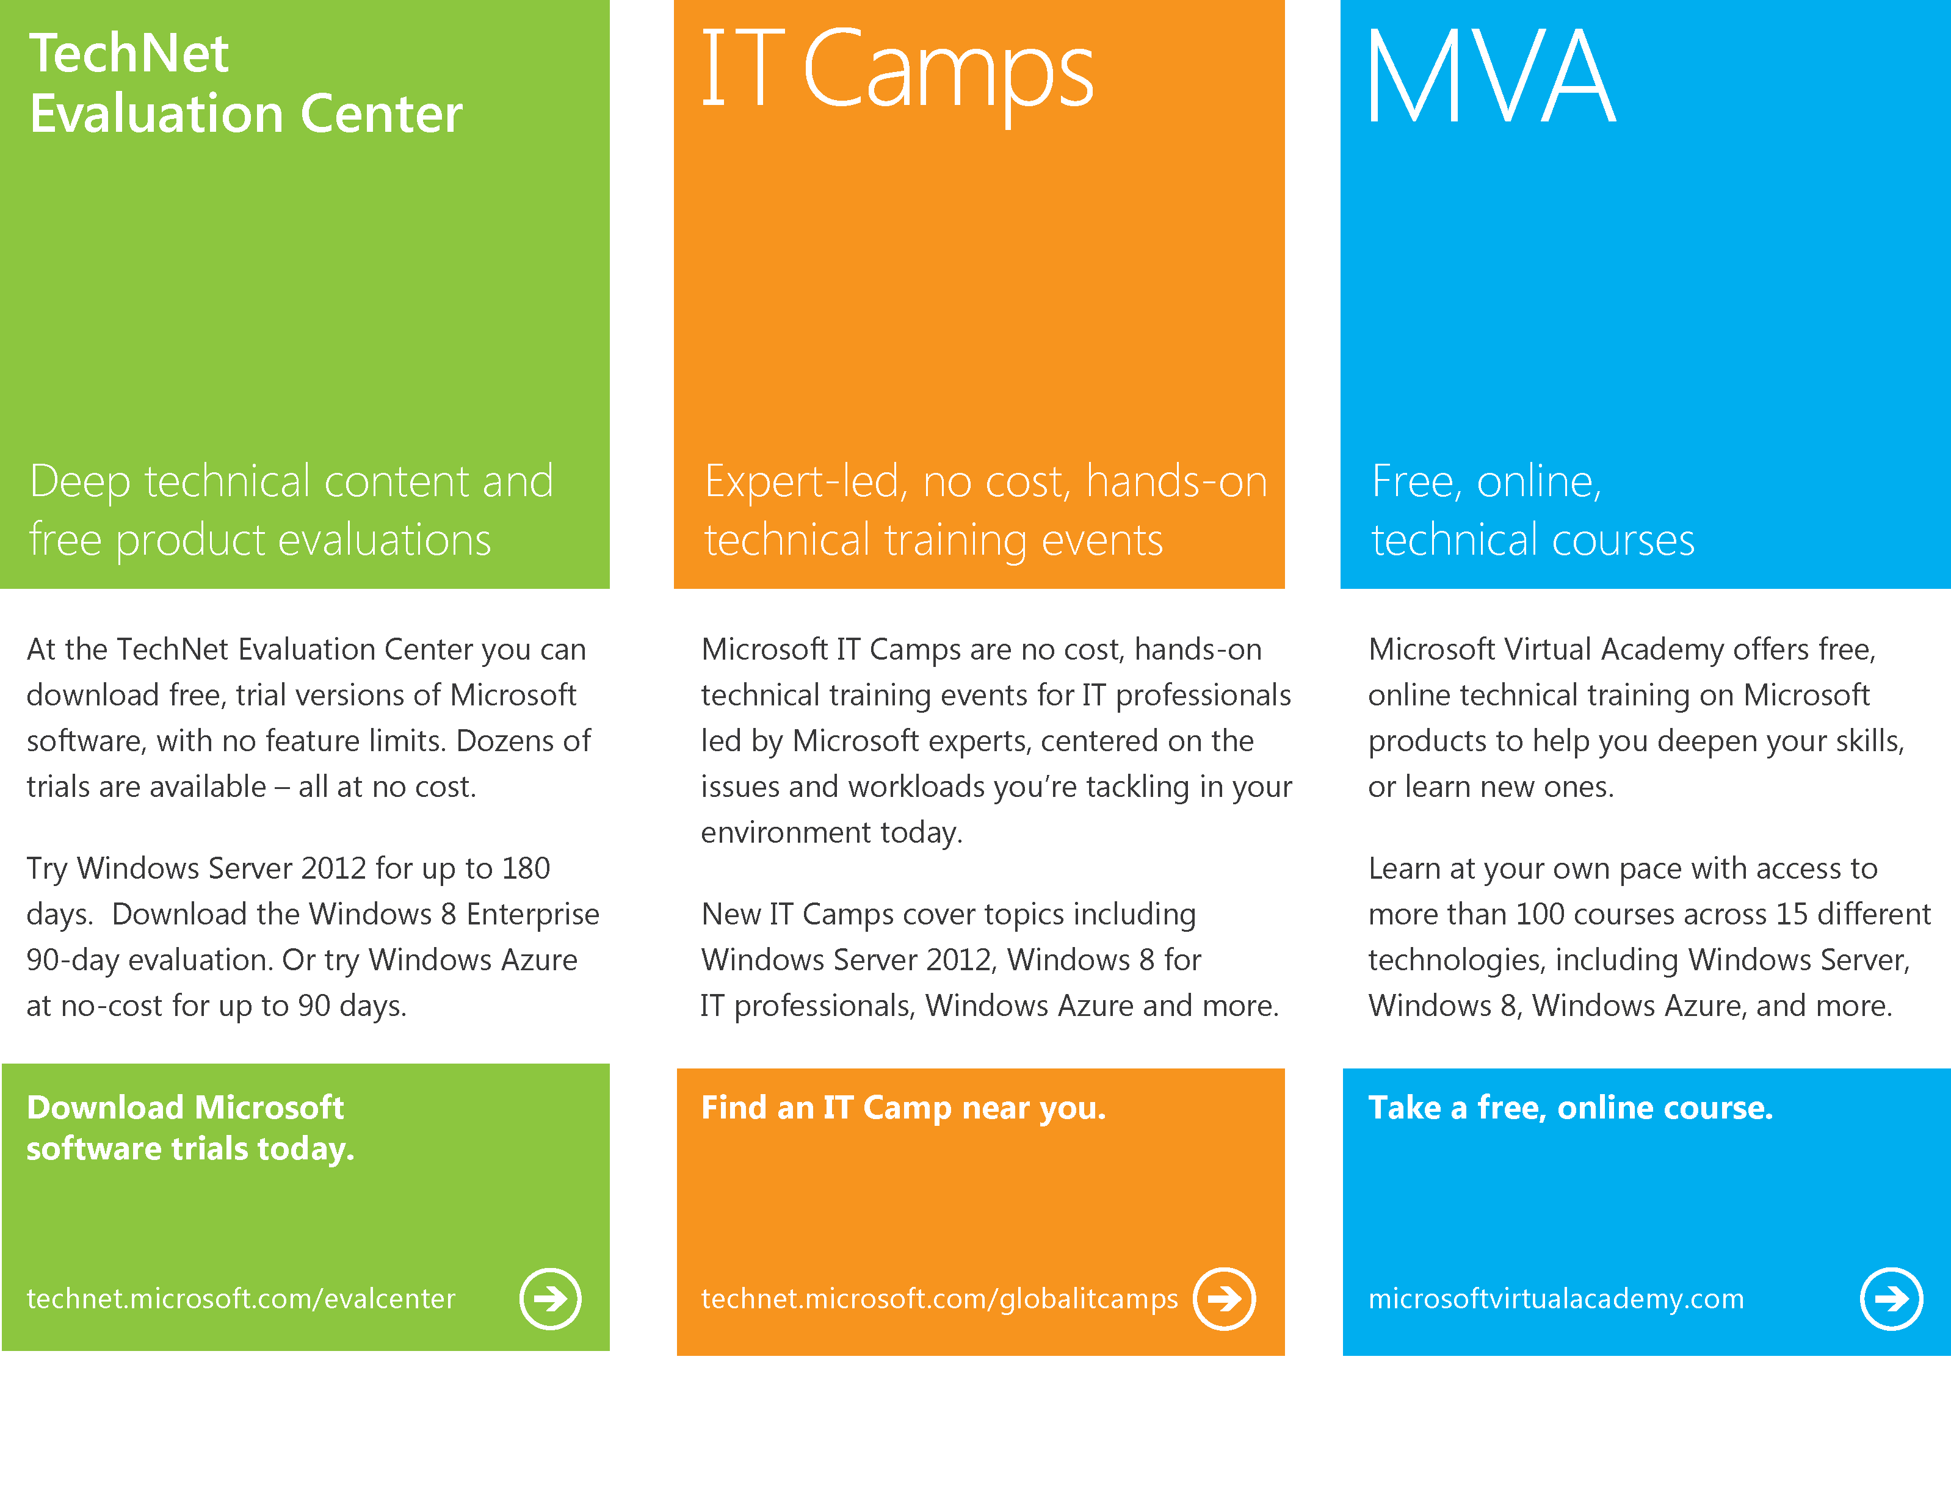
Notes:
With that, I would like to highlight again the content that is available out there for free. First of all the TechNet Eval Center on technet.microsoft.com/eval center where you can download free trial versions of Microsoft software. Then, IT Camps on technet.microsoft.com/globalitcamps which has a lot of technical training events for IT pros and, of course, the Microsoft Virtual Academy which gives you online technical training on Microsoft products for free as well.

Slide 12

© 2012 Microsoft Corporation. All rights reserved. Microsoft, Windows, Windows Vista and other product names are or may be registered trademarks and/or trademarks in the U.S. and/or other countries.
The information herein is for informational purposes only and represents the current view of Microsoft Corporation as of the date of this presentation. Because Microsoft must respond to changing market conditions, it should not be interpreted to be a commitment on the part of Microsoft, and Microsoft cannot guarantee the accuracy of any information provided after the date of this presentation. MICROSOFT MAKES NO WARRANTIES, EXPRESS, IMPLIED OR STATUTORY, AS TO THE INFORMATION IN THIS PRESENTATION.
Notes:
With that, thank you very much for your time and hope to see you soon on our next session about Orchestrator 2012. Thank you.

